Slide 1
N-set Cache/RAM System with LRU Replacement Strategy
Brennan Borchert, Luke Saleh, Quinlan Stewart,
Nikodem Gazda
VIDEO LINK:
(1) N-set Cache/RAM System with LRU Replacement Strategy - YouTube

Slide 2
Original proposal description
Implement a cache/RAM system using SystemVerilog
N-set associative cache
Configurable at compile time
Modules for cache data storage, cache tags, cache valid bits
LRU buffer and logic in one module, hit/miss logic in another, miscellaneous control in a third
Directed and randomized test benches for each module
Constrained random verification
Real-world cases (directed tests)
Utilize assertions and additional reference models/logic to check output correctness

Slide 3
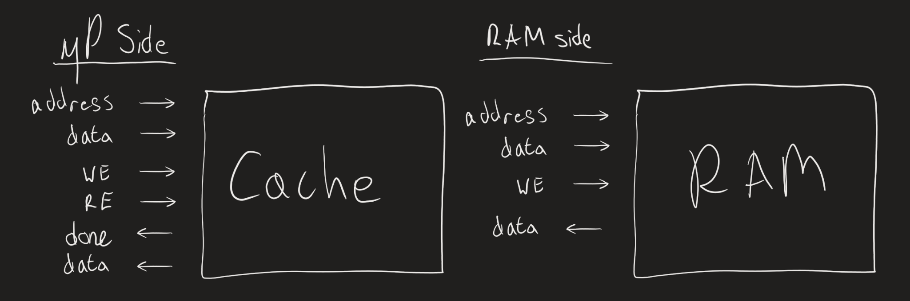
Project Progress Presentation: Cache/RAM Interface
Notes:
In this block diagram we have the Cache and the RAM it interfaces with. As we’ll see in the next slide, the cache is composed of 6 functional blocks: The Cache Data block, Tag block, Valid bit block, the Hit/Miss Logic block, the LRU Logic block, and the Control logic block.
To configure the Cache size, you specify the total size you want the cache to be and the number of banks you’d like. In all our testing, we used a 4-set cache with a total size of 16 bytes, which means the index only has 4 possible addresses.
The cache has 4 total operations: a write hit, a write miss, a read hit, or a read miss. The miss operations take 3 cycles to complete and the read operations take 2 cycles to complete.
The RAM is configured using only the RAM size, we use 256 Bytes. Each RAM read and write take only 1 cycle with reads occurring when the write enable is low.

Slide 4
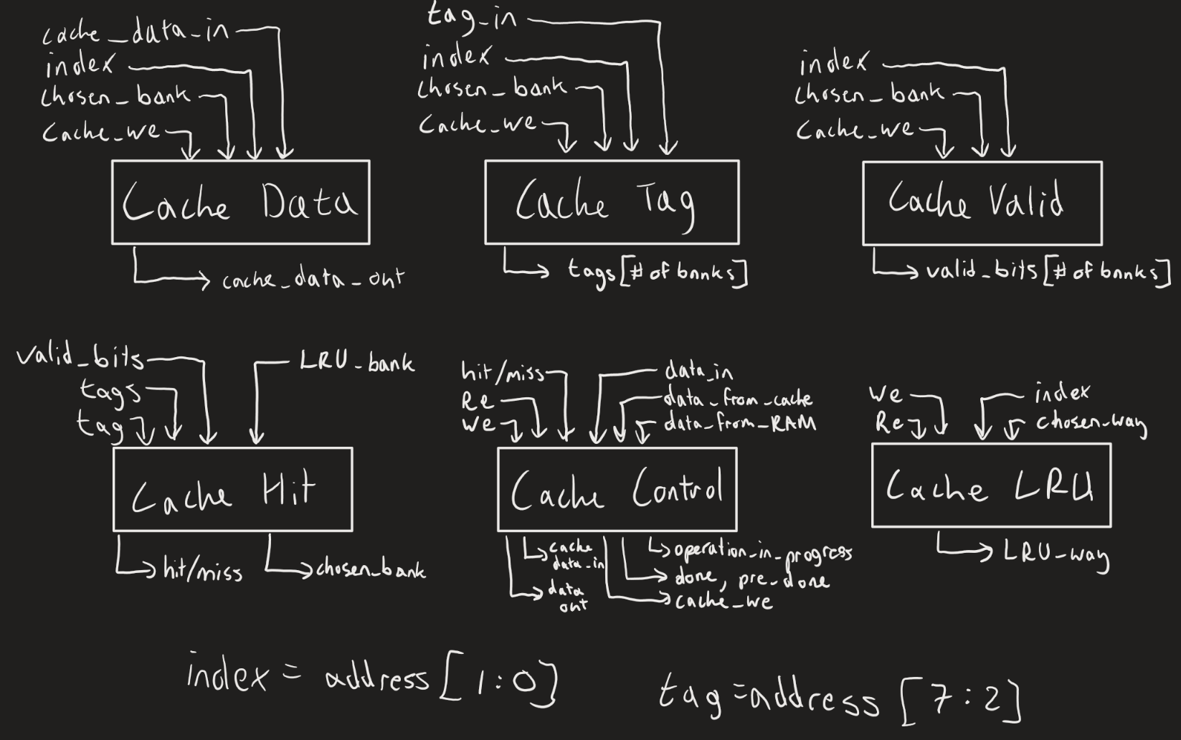
Project Progress Presentation: Cache Block Diagram
Notes:
The following are the contents of the cache.
The top three blocks are the memory storage blocks:
The Cache Data block stores the actual data in the cache.
The Cache Tag block stores the tags for each byte of data stored in the cache
The Cache Valid block stores the valid bit for each byte of data.
The bottom three blocks focus on the logic of the cache.
The Cache Hit block determines if the requested read/write is present in the cache, meaning if the requested operation is a hit or miss, and also outputs the bank relevant to the index of the current operation.
The Cache Control block handles all the miscellaneous logic in the cache, including the done signal, internal write enables used for the storage blocks, cache input data muxing (since the cache data block sometimes needs to fetch data from the RAM and sometimes from the data input from the microprocessor), and data output muxing.
The Cache LRU block stores the pointers to the least recently used banks for each index and outputs the least recently used one.
For more information on these blocks, please refer to the extended Cache Documentation in our submission.

Slide 5
Project progress presentation: Verification
Example: Cache Hit block
Directed Testcases (Each repeated 5x)
Test 1: all tags are 0, 1, 2, 3, target tag is 0, valid bits are 0, lru_way is 0
Test 2: all tags are 0, 1, 2, 3, target tag is 0, valid bits are 0, lru way is 1
Test 3: all tags are 0, 1, 2, 3, targt tag is 0, valid bits are 1, lru way is 2
Test 4: all tags are 0, 1, 2, 3, targt tag is 1, valid bits are 1, lru way is 3
Test 5: all inputs are 0s
Test 6: all inputs are 1s
Constrained-Randomized Testcases
target_tag_ranges, lru_way_ranges, tags_ranges
Tags_never_same
target_tag_match
Assertions
Miss_check
Hit_check
Tags_match
No_tags_match
Notes:
As of the time of the Project Progress report, we had completed the designs and testbenches for each individual block, with the top-level integration and testbench remaining.
Each block had its own unique implementation of the testbenches. As an example, below are the directed and random testcases for the Cache Hit block.
There are 6 unique directed testcases, each repeated 5 times, with each testcase describing the inputs below.
We also conducted constrained-random verification with the following constraints:
- The target tag, least recently used bank from the LRU, and the cache tags are all randomized with a 10% chance for all 0s, 10% chance for all 1s, and an 80% chance for all other combinations.
- The cache tags, which are the tags for each bank of the current index, must never be the same.
- The target tag matches one of the cache tags 50% of the time to make sure we test for hits and misses equally.
Each test also had its own set of assertions and additional reference models/logic for testing. The Cache Hit block had the following assertions:
- Miss_check: If a miss is reported, the chosen bank must match the lru bank.
- Hit_check: If a hit is reported, the tag corresponding to the chosen bank must match the target tag.
- Tags_match: If any of the tags match the target tag, there should be a hit reported.
- No_tags_match: When no tags match the target tag, we expect a miss.

Slide 6
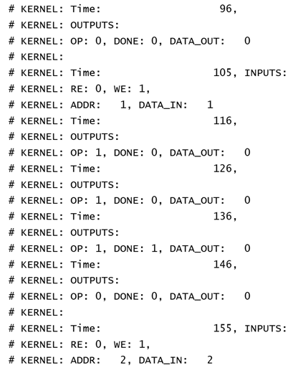
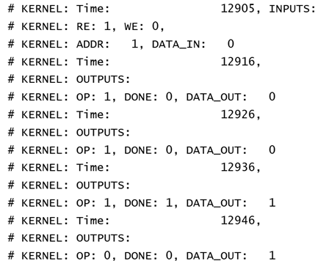
Results: Top-Level Testbench (Write/Read Miss)
Notes:
The Top-Level testbench consists of a set of direct testcases and random testcases.
In the first directed testcase, we test for Write Miss and Read Miss operations by writing to every RAM address first and then reading from every address afterwards. Since each address access is separated by the reads and writes of all the other addresses, each operation will be a miss.
This testcase ensures that data that is written is maintained over longer periods of time, even as other indices and banks are written to and read from.
Here is a snippet of the first directed testcase. In the left image, you can see a Write Miss operation happen at address 1 with data input of 1, and the start of the same operation for address/data 2. In the right image, you can see a Read Miss operation take place in 3 cycles (as expected) with the written data of 1.
For more detail please see the extended Cache Documentation or run the code in the EDA playground linked in the submission. We’ll also show this testcase in the demo.

Slide 7
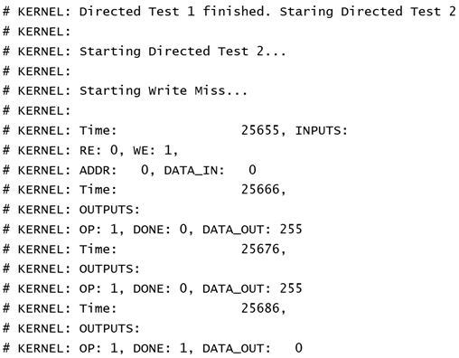
Results: Top-Level Testbench (Write/Read Hit)
Notes:
In the second directed testcase, we test for Write Hit and Read Hit operations by writing to every RAM address twice and reading from the same address immediately afterwards. This is then repeated for each address. Since each address access is sequential, the second write and first read for each operation will be a hit.
This testcase ensures that data is written and read in the expected delay time.
In the snippet of Directed Hit testcase 2, we perform a Write Miss with address 0 and data input 0.

Slide 8
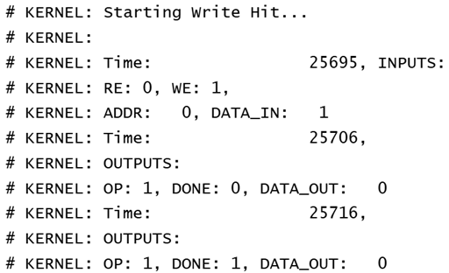
Results: Top-Level Testbench (Write/Read Hit)
Notes:
The next operation we perform is a Write Hit to address 0 (hit because address 0 is currently in the cache) and data input 1.

Slide 9
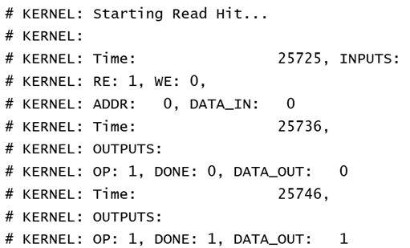
Results: Top-Level Testbench (Write/Read Hit)
Notes:
We then perform a Read Hit (hit for the same reason as the write before) which returns the previously written value of 1. Note that the Hit operations only take 2 cycles.

Slide 10
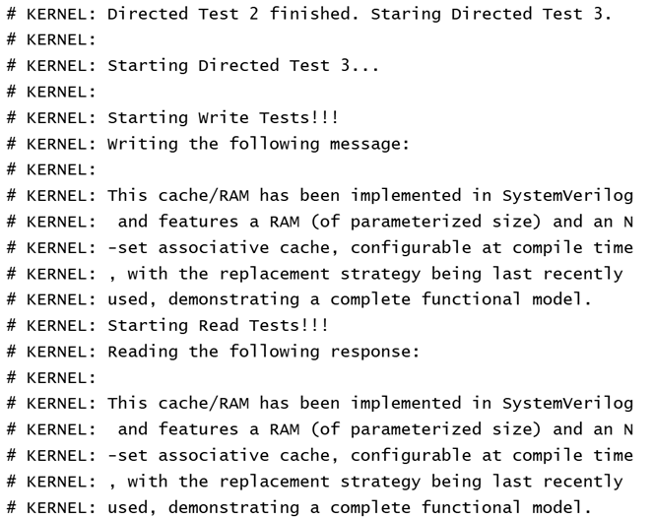
Results: Top-Level Testbench (Example Use Case)
Notes:
This testcase shows off an example use case. As with the first directed testcase, here, we write one character of a message to each address of the RAM. Once each character is written, we read back the data from each address, store it in a string in the testbench, and display the returned message to see if we get the same message back.

Slide 11
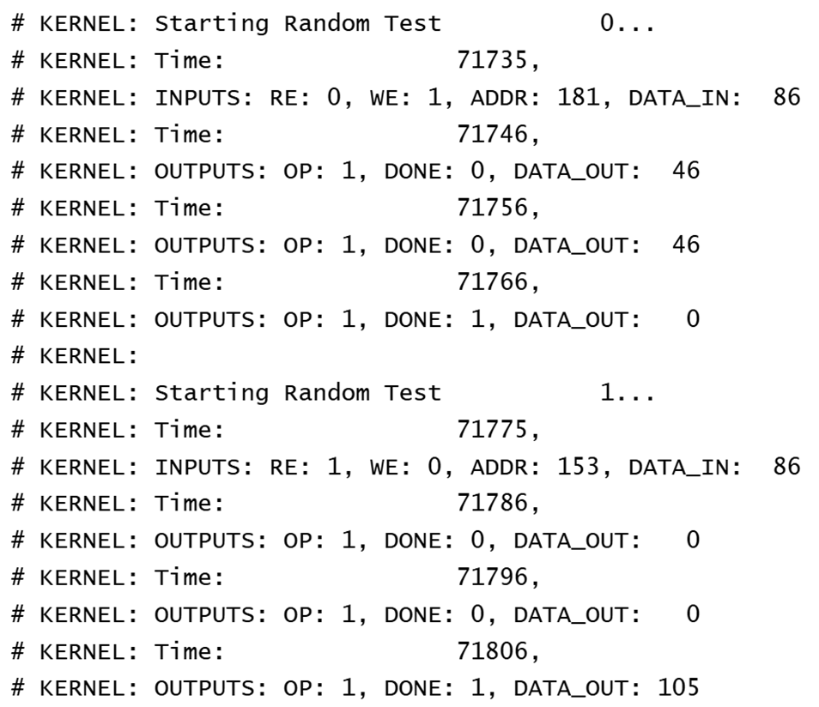
Results: Top-Level Testbench (Random test)
Notes:
In these random testcase snippets, we see a Write Miss, a Read Miss, a Write Miss, and a Read Hit. The first two are seen in the first image on this slide, where data value 86 is written to address 181 in 3 cycles since it’s a miss. Note that the output changes to 0 when the operation is complete. The next instruction is a Read Miss that returns data value 105 from address 153. This value is left over from the previous directed testcase where we write the first 256 characters of this documentation to the cache and corresponds to the letter ‘i’.

Slide 12
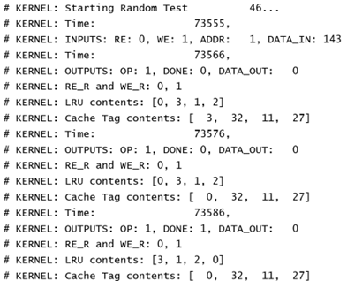
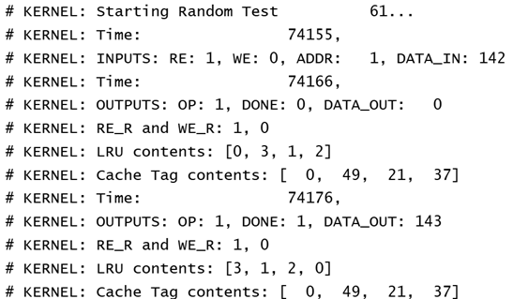
Results: Top-Level Testbench (Random test)
Notes:
Here, we perform a Write Miss of value 143 to address 1 in Random Test 46. Later, in the next image in Random Test 61, address 1 is still in the cache and we return the same value 143 after a Read Hit. These testcases have some extra debugging information but the operation is still correct.

Slide 13
Summary
Lessons Learned: Clear functionality specs prevent redesigns and confusion.
Future Work: Add pipelining and redesign as an FSM for efficiency.
Experience Gained: Improved skills in design, verification, and SystemVerilog.
Challenge and Reward: A challenging yet rewarding practice of industry standards.
Notes:
This was an extremely fun and challenging project. We learned that it’s much easier to implement a design by first very clearly specifying the functionality and ONLY then implementing it in code. This is how it’s done in the industry, but we underplayed the complexity of the design and thought we could jump straight into the implementation. Because of this, we had to go back and change the design many, many times in the middle of verification. The design got confusing and we only started making progress once everything was set in stone.
Future work would include reconstructing the system to allow for pipelining. This would not only improve the efficiency/throughput but also likely simplify the logic so that operations don’t overlap. Future work would also include reconstructing the design as an FSM rather than a set of blocks of logic.
This project was both a good practice of our understanding of caches/the algorithms that help them work and of hardware design/verification. It feels like we used every single SystemVerilog concept under the sun out of pure necessity (not just to look pretty), considering we wrote ~3k lines of testbench code, ~1k lines of design code, and ~4k lines of code total.

Slide 14
DEMO
https://www.edaplayground.com/x/BhLN
Notes:
This was an extremely fun and challenging project. We learned that it’s much easier to implement a design by first very clearly specifying the functionality and ONLY then implementing it in code. This is how it’s done in the industry, but we underplayed the complexity of the design and thought we could jump straight into the implementation. Because of this, we had to go back and change the design many, many times in the middle of verification. The design got confusing and we only started making progress once everything was set in stone.
Future work would include reconstructing the system to allow for pipelining. This would not only improve the efficiency/throughput but also likely simplify the logic so that operations don’t overlap. Future work would also include reconstructing the design as an FSM rather than a set of blocks of logic.
This project was both a good practice of our understanding of caches/the algorithms that help them work and of hardware design/verification. It feels like we used every single SystemVerilog concept under the sun out of pure necessity (not just to look pretty), considering we wrote ~3k lines of testbench code, ~1k lines of design code, and ~4k lines of code total.

